Slide 1
AngularJS

Slide 2
Contents
Introduction
AngularJS Extends HTML
AngularJS Directives
AngularJS Expressions
AngularJS Modules
AngularJS Directives
AngularJS Filter
More feature

Slide 3
Introduction
AngularJS extends HTML with new attributes.
AngularJS is perfect for Single Page Applications (SPAs).
AngularJS is a JavaScript framework. It can be added to an HTML page with a <script> tag.
<script src="https://ajax.googleapis.com/ajax/libs/angularjs/1.6.9/angular.min.js"></script>
AngularJS is distributed as a JavaScript file
AngularJS starts automatically when the web page has loaded.

Slide 4
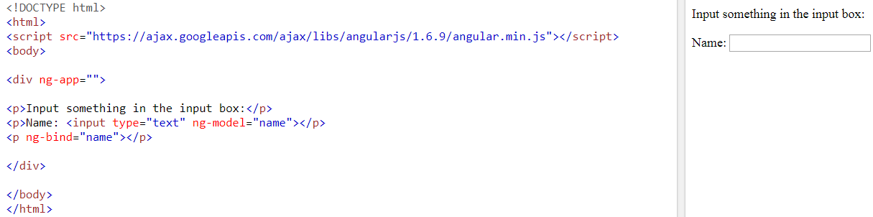
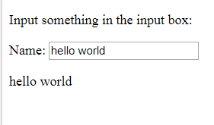
AngularJS Extends HTML
The ng-app directive defines an AngularJS application (The ng-app directive tells AngularJS that the <div> element is the "owner" of an AngularJS application.)
The ng-model directive binds the value of HTML controls (input, select, textarea) to application data (variable name).
The ng-bind directive binds application data (variable name) to the HTML view (p).
Notes:
Will write on p as soon as we start writing. Will not load whole page to write it.

Slide 5
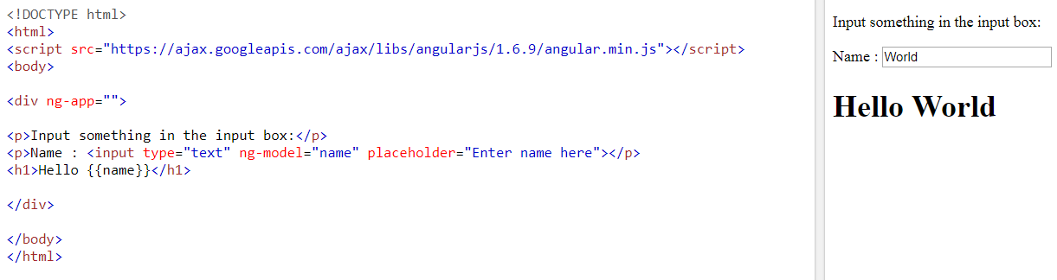
Example

Slide 6
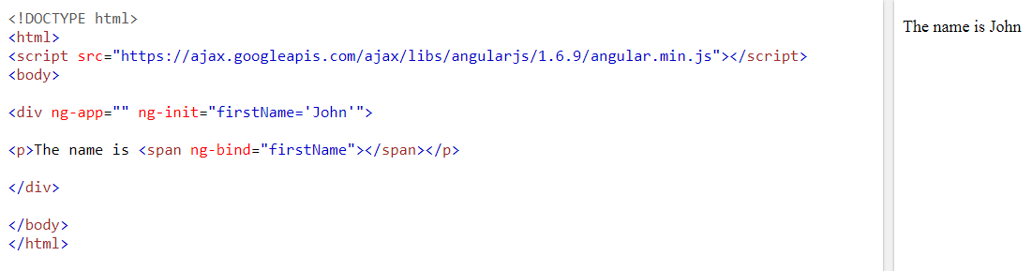
AngularJS Directives
The ng-init directive initializes AngularJS application variables.

Slide 7
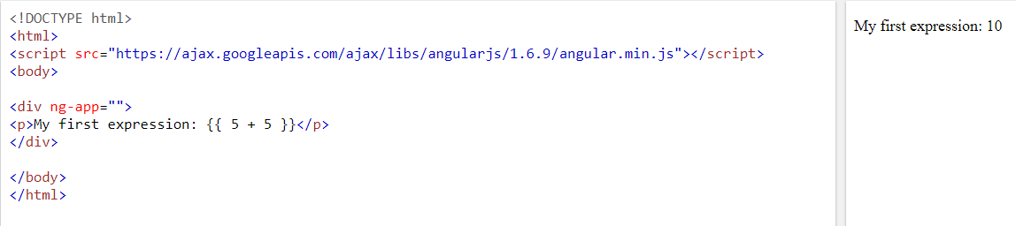
AngularJS Expressions
AngularJS expressions are written inside double braces: {{ expression }}.

Slide 8
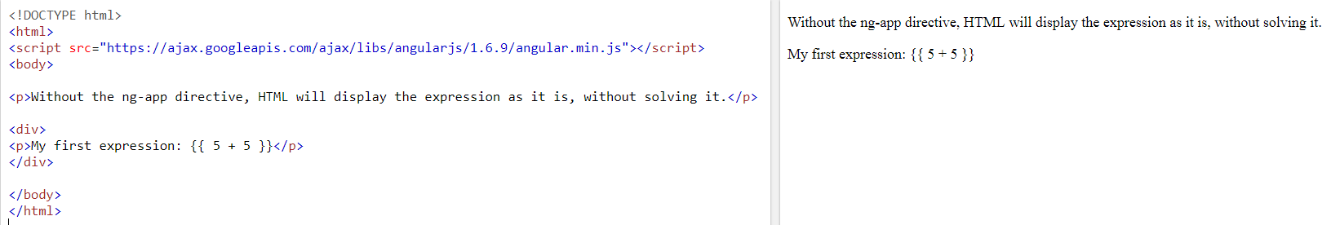
Contd.
If you remove the ng-app directive, HTML will display the expression as it is, without solving it:

Slide 9
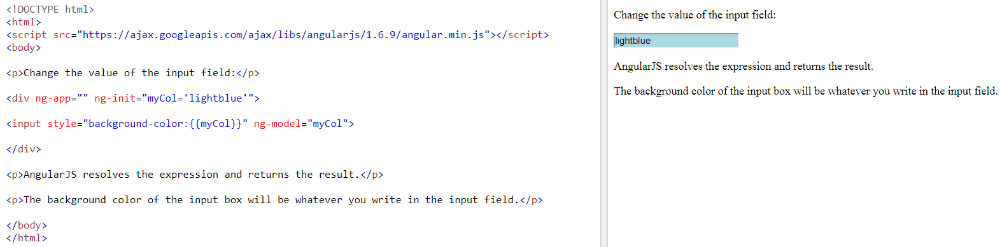
Contd.
AngularJS change the value of CSS properties

Slide 10
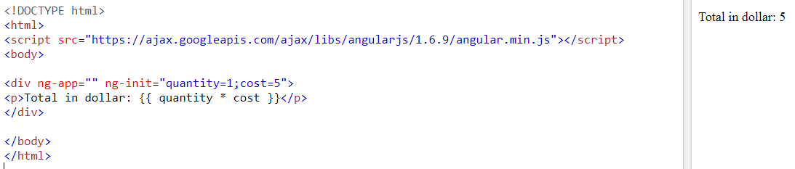
AngularJS Numbers
Notes:
Can be done using ng-bind
<!DOCTYPE html>
<html>
<script src="https://ajax.googleapis.com/ajax/libs/angularjs/1.6.9/angular.min.js"></script>
<body>
<div ng-app="" ng-init="quantity=1;cost=5">
<p>Total in dollar: <span ng-bind="quantity * cost"></span></p>
</div>
</body>
</html>

Slide 11
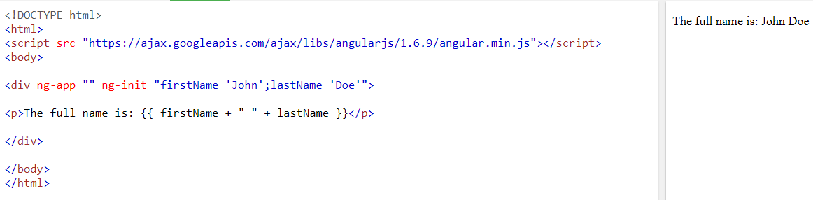
AngularJS Strings
Notes:
Can be done using ng-bind
<div ng-app="" ng-init="firstName='John';lastName='Doe'"> <p>The name is <span ng-bind="firstName + ' ' + lastName"></span></p> </div>

Slide 12
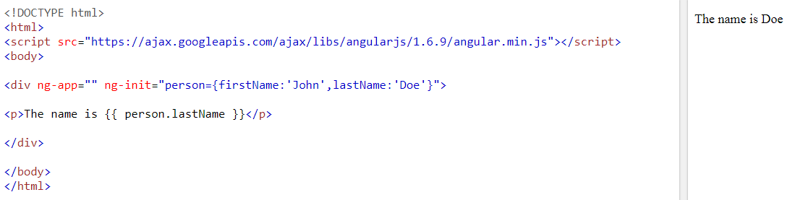
AngularJS Objects
Notes:
Can be done using ng-bind
<div ng-app="" ng-init="person={firstName:'John',lastName:'Doe'}"> <p>The name is <span ng-bind="person.lastName"></span></p> </div>

Slide 13
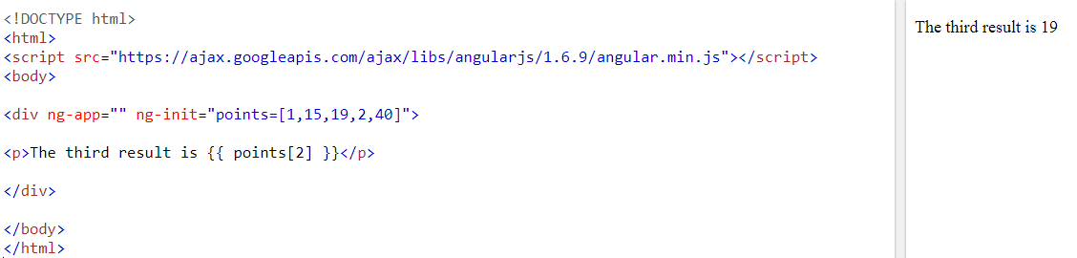
AngularJS Arrays
Notes:
Can be done using ng-bind
<div ng-app="" ng-init="points=[1,15,19,2,40]"> <p>The third result is <span ng-bind="points[2]"></span></p> </div>

Slide 14
AngularJS Expressions vs. JavaScript Expressions
Like JavaScript expressions, AngularJS expressions can contain literals, operators, and variables.
Unlike JavaScript expressions, AngularJS expressions can be written inside HTML.
AngularJS expressions do not support conditionals, loops, and exceptions, while JavaScript expressions do.
AngularJS expressions support filters, while JavaScript expressions do not.

Slide 15
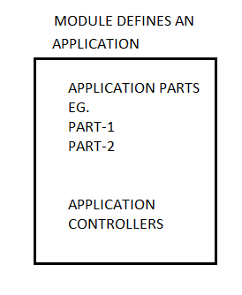
AngularJS Modules
An AngularJS module defines an application.
The module is a container for the different parts of an application.
The module is a container for the application controllers.
Controllers always belong to a module.

Slide 16
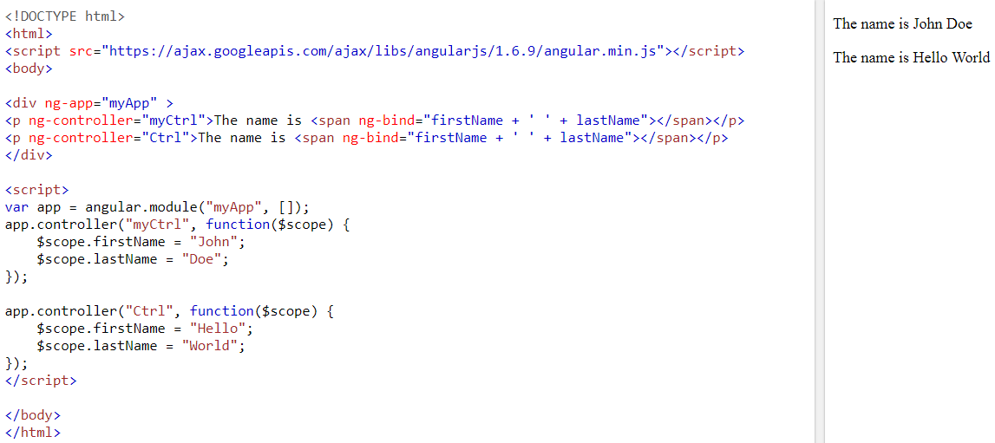
Contd.
Notes:
The AngularJS application is defined by ng-app="myApp". The application runs inside the <div>.
The ng-controller="myCtrl" attribute is an AngularJS directive. It defines a controller.
AngularJS will invoke the controller with a $scope object. The scope is the binding part between the HTML (view) and the JavaScript (controller).
In AngularJS, $scope is the application object (the owner of application variables and functions).

Slide 17
AngularJS Directives
AngularJS lets you extend HTML with new attributes called Directives.
AngularJS has a set of built-in directives which offers functionality to your applications.
AngularJS also lets you define your own directives.
AngularJS directives are extended HTML attributes with the prefix ng-.
The ng-app directive initializes an AngularJS application.
The ng-init directive initializes application data.
The ng-model directive binds the value of HTML controls (input, select, textarea) to application data

Slide 18
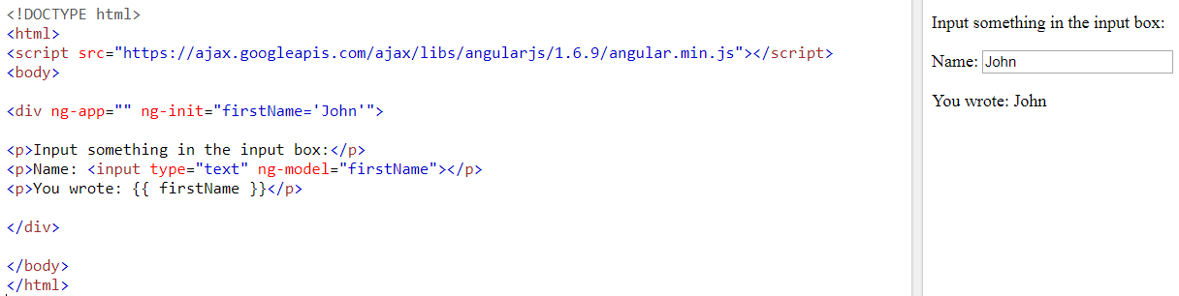
Example

Slide 19
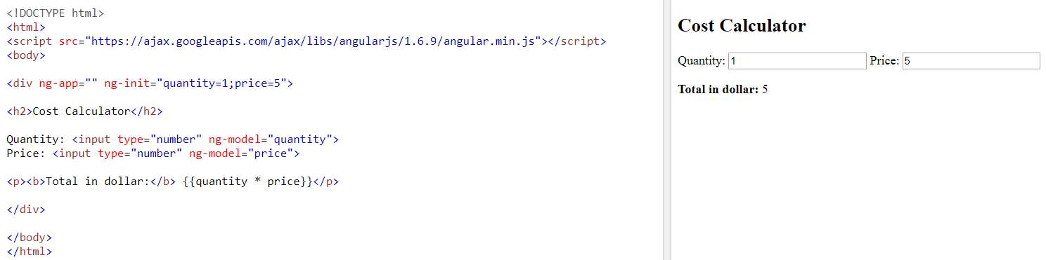
AngularJS Directives-Data Binding

Slide 20
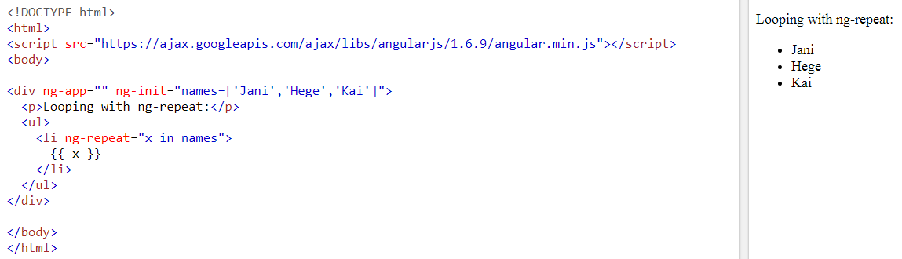
AngularJS Directives-Repeating HTML Elements

Slide 21
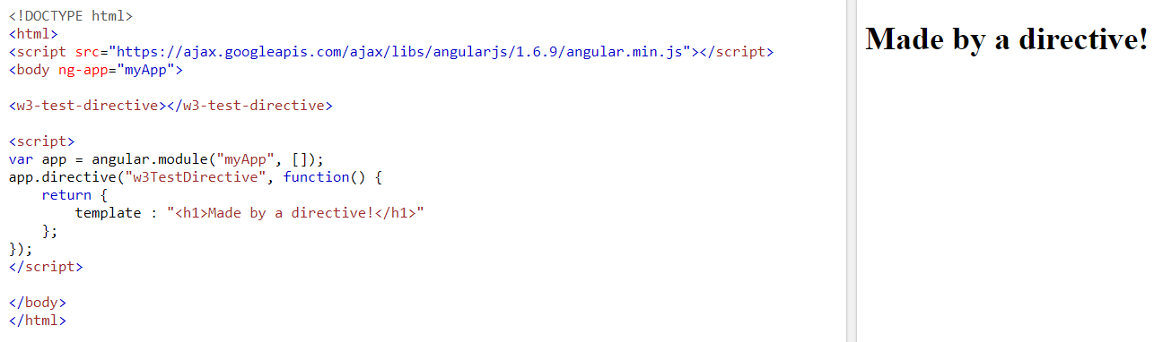
Create New Directives
New directives are created by using the .directive function.
To invoke the new directive, make an HTML element with the same tag name as the new directive.
When naming a directive, you must use a camel case name, w3TestDirective, but when invoking it, you must use - separated name, w3-test-directive:

Slide 22
AngularJS Filters
AngularJS provides filters to transform data:
lowercase Format a string to lower case.
uppercase Format a string to upper case.
orderBy Orders an array by an expression.
currency Format a number to a currency format.
filter Select a subset of items from an array.
date Format a date to a specified format.
number Format a number to a string.

Slide 23
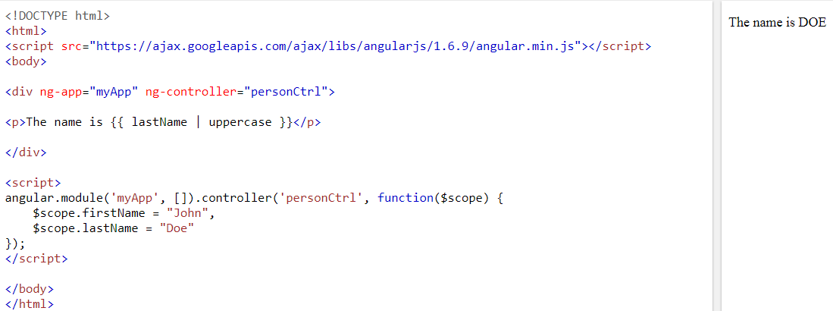
Adding Filters to Expressions
Filters can be added to expressions by using the pipe character |, followed by a filter. The uppercase filter format strings to upper case:

Slide 24
Contd.
The lowercase filter format strings to lower case:
<div ng-app="myApp" ng-controller="personCtrl"> <p>The name is {{ lastName | lowercase }}</p> </div>

Slide 25
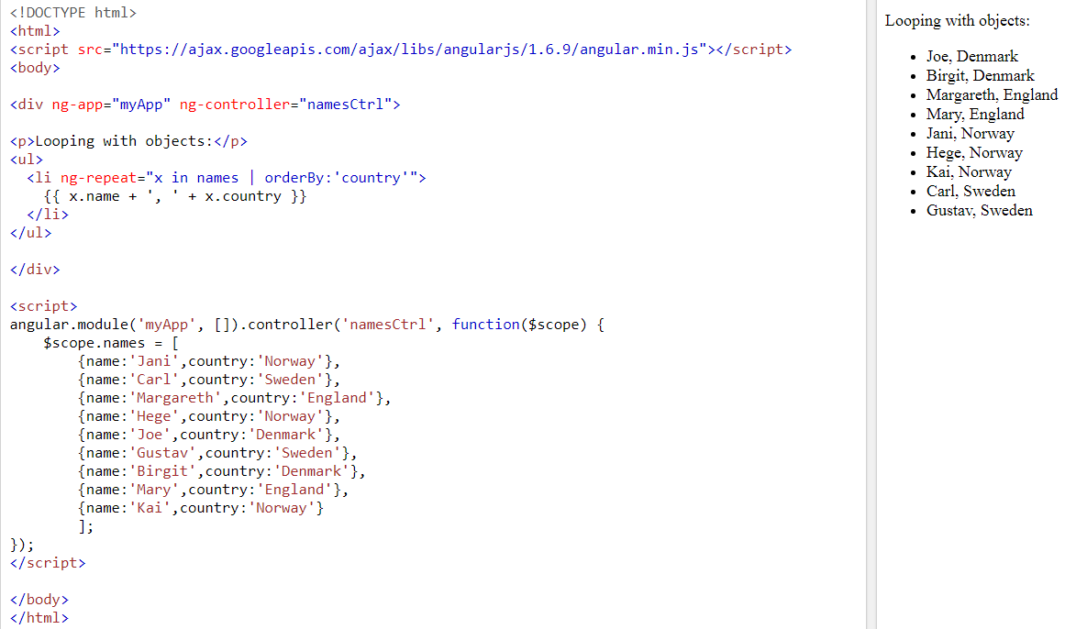
Adding Filters to Directives

Slide 26
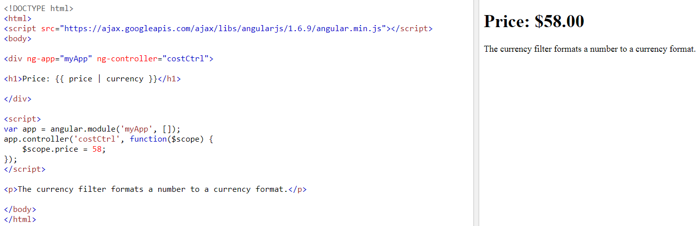
The currency Filter

Slide 27
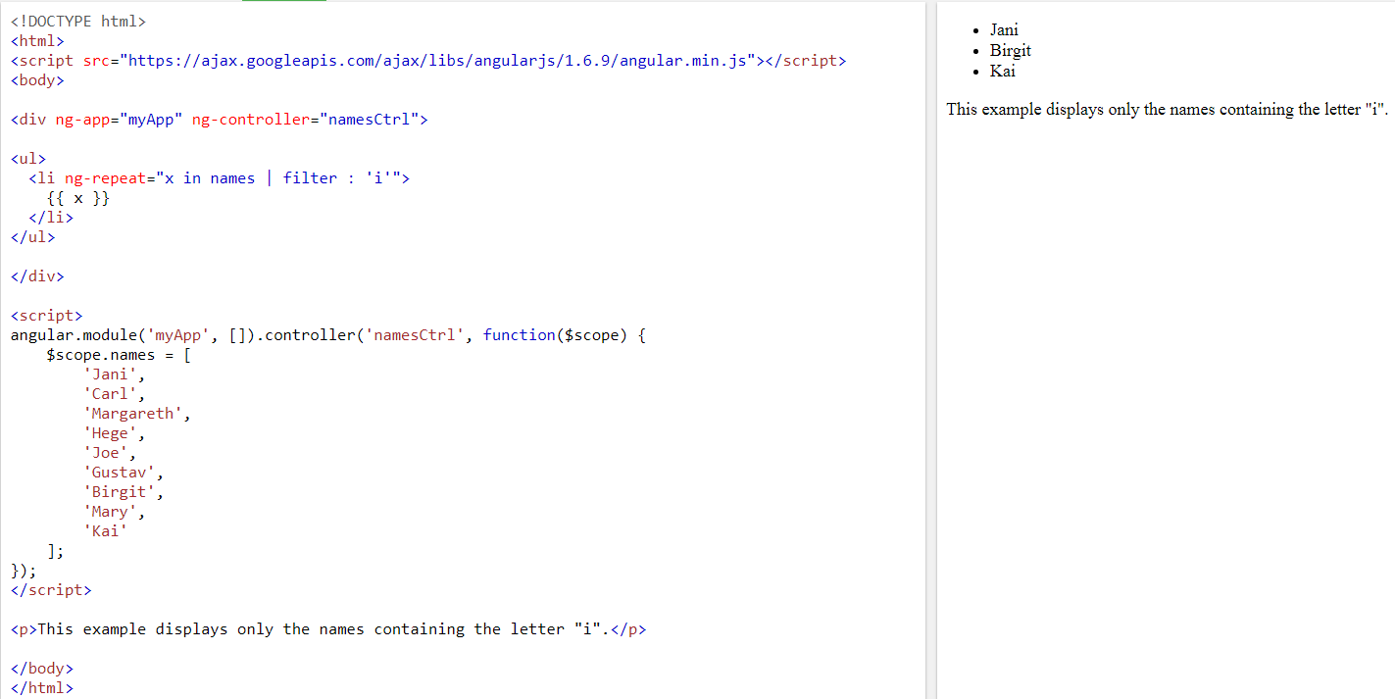
The filter Filter
Notes:
The filter filter selects a subset of an array.
The filter filter can only be used on arrays, and it returns an array containing only the matching items.

Slide 28
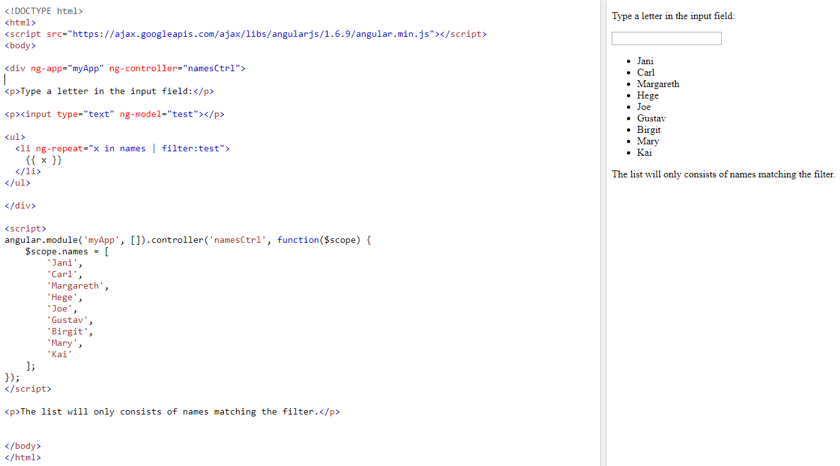
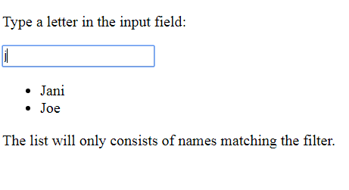
Filter an Array Based on User Input

Slide 29
More features
Displaying of Tables (using ng-repeat)
Create a Select Box Using ng-options
AngularJS has directives for binding application data to the attributes of HTML DOM elements.
AngularJS Events (ng-blur, ng-change, ng-click, ng-copy, ng-cut, ng-dblclick, ng-focus etc.)
Forms in AngularJS provides data-binding and validation of input controls.
Provides animation effects like jQuery

Slide 30
Project
Choose any project of your choice
Submit proposal of it by next lecture (9th Oct)
Individual Project
Should contain every technology which we have covered or will cover in the upcoming lectures
Deadline: a week before finals (in last week project will be evaluated)

Slide 31
Assignment due on 15th Oct
Use Bootstrap to make a single page website (of your choice)
Bootstrap is a free and open-source front-end framework for designing websites and web applications. It contains HTML- and CSS-based design templates for typography, forms, buttons, navigation and other interface components, as well as optional JavaScript extensions.

